Slide 1
Introduction to Containers
AQUA-FAANG: Bioinformatic analysis of regulatory elements
Thomas Juettemann, EMBL-EBI
10 - 12 May 2021
Notes:
Hello Everyone and welcome.
In this segment of the course I will introduce you to container technologies and Docker.
First we look into what caused the need for this technology, then we explore what a container actually is, how it compares to a virtual machine, where to get images, and then we'll finish with the most common docker commands before the exercises.

Slide 2

How did we get here?

Slide 3

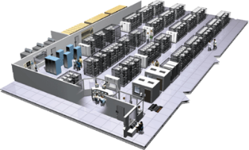
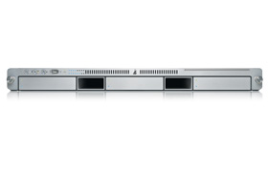

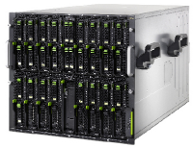

The Challenge
Static website
User DB
Queue
nginx 1.5 + modsecurity + openssl + bootstrap 2
postgresql + pgv8 + v8
HDF5 + kita
Redis +
redis-sentinel
Analytics DB
Do services and apps interact appropriately?
Multitude
of
Stacks
hadoop + hive + thrift
+ OpenJDK
Background workers
Web frontend
API endpoint
Python 3.9 + genrich + ataqv
+ phantomjs
Ruby + Rails + sass +
Unicorn + hdfview
Python 2.7 + Flask + pyredis +
celery + psycopg + postgresql-client
Development VM
Production
Cluster
Public Cloud
Multiplicity of hardware environments
Can I migrate smoothly and quickly?
QA server
Disaster recovery
Data Center(s)
Contributor’s laptop
Production Servers
Notes:
Modern day development lives in a complex world. For even the most basic application you are likely to have a back-end language that lives on the server, a front-end language that lives on the client, third-party and in-house libraries for both languages, a database, an operating system, often deploying to Linux but developing on a different one. And this is for a basic app!
What if you have utility programs that are written in another language? What if you have other uncommon dependencies and requirements? The uncommon of course being actually very common in bioinformatics.
All this adds up to a lot of complexity, and worst of all- it is complexity that you have to manage across multiple platforms.
While these examples are focused on tools that are published as a service in web, I personally experienced similar problems many times.
If I got an app up and running on my MacBook and then want to use it on the EBI farm, I knew I was in for some fun times: Linux brew vs home brew, different compilers and no root rights.
While everything should be the same, it never quite was.
Personally I found that spending my time fighting with compilers and dependencies very frustrating and a waste of my time.
These troubles have been nicely summed up as

Slide 4
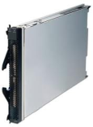
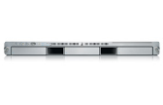
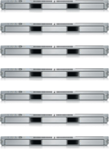


The Matrix From Hell
? | ? | ? | ? | ? | ? | ?
? | ? | ? | ? | ? | ? | ?
? | ? | ? | ? | ? | ? | ?
? | ? | ? | ? | ? | ? | ?
? | ? | ? | ? | ? | ? | ?
? | ? | ? | ? | ? | ? | ?
Static website
Web frontend
Background workers
User DB
Analytics DB
Queue
 | Development VM | QA Server | Single Prod Server | Onsite Cluster | Public Cloud | Contributor’s laptop | Customer Servers
Notes:
“Matrix from Hell”.
Every software component, multiplied by every environment where it has to run at some point.
Don’t forget, other people might want to use your tool as well.
Everything must work.
Code is developed on a laptop, and then copied to a computer cluster.
You have collaborators who use a different OS or different MySQL version.
Your paper with the tool got published, hundreds of people are using it.
A few dozens don’t get it to run, and suddenly you find yourself doing user support of for hours and hours.
In simple words, it is the challenge of packaging any application, irrespective of language/frameworks/dependencies, so that it can run on any system, irrespective of the underlying OS/hardware/infrastructure.
We can’t surely be the first people to experience that issue? Is there another group of people who has the same problem?

Slide 5
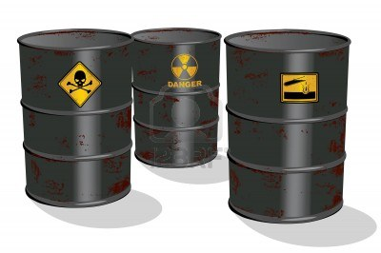

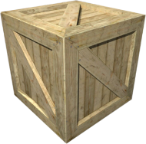
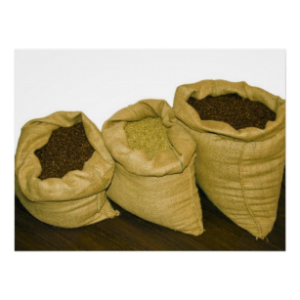
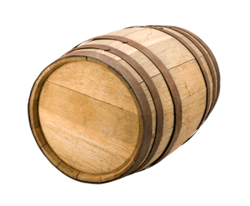
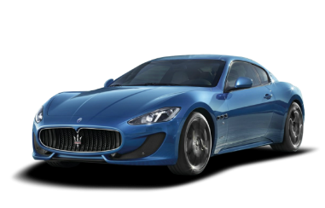
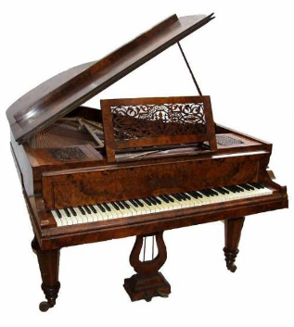



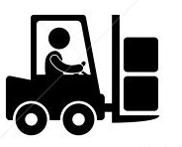
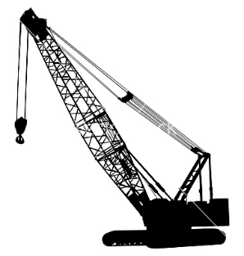
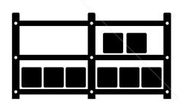

Cargo Transport Pre-1960
Do I worry about how goods interact (e.g. coffee beans next to spices)
Multiplicity of Goods
Multiplicity of methods for transporting/storing
Can I transport quickly and smoothly
(e.g., from boat to train to truck)
Notes:
Cargo transport pre-1960 faced similar issues.
I need to ship coffee beans,
I need to get them from one to the other side of the world.
It is MY problem how the goods are handled at EVERY STEP of the way.
Is all the staff involved trained?
What trucks to use?
The type of shipping also depends on the type of my goods.
That means that every provider needs an expert in-house who maps out routes and has the knowledge of the means of transports involved.
That makes it a very fragile and expensive process.

Slide 6
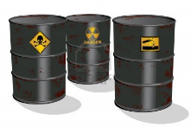




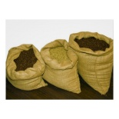


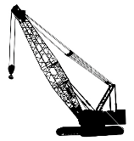



Also a matrix from hell
 | ? | ? | ? | ? | ? | ? | ?
 | ? | ? | ? | ? | ? | ? | ?
 | ? | ? | ? | ? | ? | ? | ?
 | ? | ? | ? | ? | ? | ? | ?
 | ? | ? | ? | ? | ? | ? | ?
 | ? | ? | ? | ? | ? | ? | ?
Notes:
You can present that with the same Matrix of Hell.
Every item to ship multiplied by every possible way to ship it.
How to solve it?
You probably already guessed it:

Slide 7

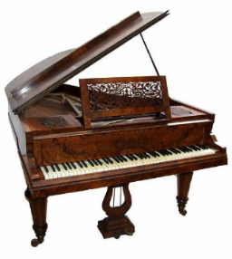

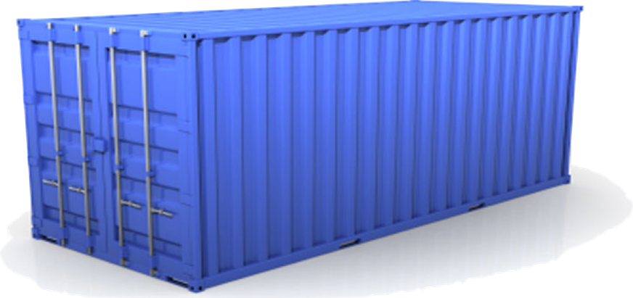
Solution: Intermodal Shipping Container
A standard container that is loaded with virtually any goods, and stays sealed until it reaches final delivery.
…in between, can be loaded and unloaded, stacked, transported efficiently over long distances, and transferred from one mode of transport to another
Notes:
Container~
They agreed on the size, the weight, how the doors work, where the locks are, where the labels are put and so on.
Infrastructure provider standardized on that, as well as people shipping goods.
With this, responsibilities shifted.
If I want to ship coffee, I only need to put it into this box and seal it.
From that point it is no longer my problem.
I can hand it over to a wide variety of infrastructure providers, and even hand it over to a provider that I never dealt with.
As an infrastructure provider I know exactly what to expect and I can focus on improving: faster boats, bigger truck, better organized facilities.

Slide 8
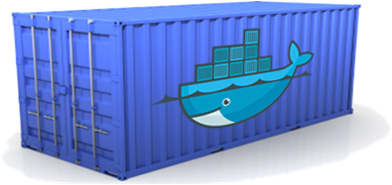
Docker is a shipping container system for code
Static website
User DB
Web frontend
Queue
Analytics DB
An engine that enables any payload to be encapsulated as a lightweight, portable, self-sufficient container…
…that can be manipulated using standard operations and run consistently on virtually any hardware platform
Development VM
QA server
Customer Data Center
Public Cloud
Production Cluster
Contributor’s laptop
Notes:
The same should be applied to software.
It is embarrassing that moving software from one data center to another takes longer than shipping good from one side of the world to the other.
Docker provides a standard way to pack software into a box, with standard properties, and then the box can be handed to other teams or infrastructure providers, and they know how to handle it.

Slide 9
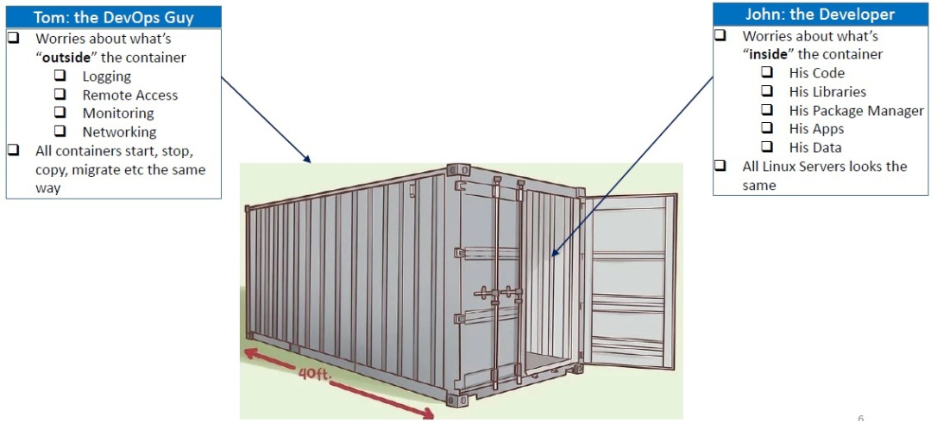
Separation of Concerns
https://crunchytechbytz.wordpress.com/2018/01/23/introduction-to-docker
Notes:
Separation of concerns
Developers can focus on bundling applications and dependencies as containers, without agonizing over underlying hardware/infrastructure.
Administrators/DevOps team can concentrate on managing containers, without agonizing over the contents of those containers.
All containers start, stop etc the same way, all Linux servers suddenly look alike.

Slide 10

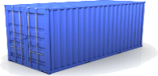
Docker eliminates the matrix from Hell
Static website
Web frontend
Background workers
User DB
Analytics DB
Queue
 | Development VM | QA Server | Single Prod Server | Onsite Cluster | Public Cloud | Contributor’s laptop | Customer Servers
Notes:
Using containers, the matrix from hell suddenly looks very cheerful.

Slide 11
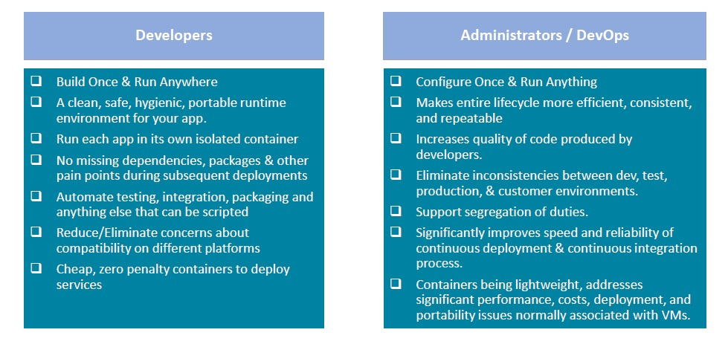
Benefits for Developers & Administrators
https://crunchytechbytz.wordpress.com/2018/01/23/introduction-to-docker
Notes:
Everyone benefits.
For developers the long standing promise that Java gave finally came through, build once and run anywhere.
As an added bonus, admins only need to configure once and then run everywhere.
Apps are isolated, no more hassle with missing dependencies, no inconsistencies, improved speed and reliability etc. Great, isn’t it?
This is usually the point where all the issues come up – but not here. It is as great as it sounds.
Container do make your life much simpler.
Now that we know that containers are great, let's see....

Slide 12
Containerisation How does it work?
Notes:
How does it work?

Slide 13


The needs of the one vs the needs of the many
VS
Single user
All resources
Multiple user
Limited resources
Data privacy
https://unsplash.com/photos/NuFUbftUu_s
https://images.app.goo.gl/aw1RRCeKKPCpf1yQ7
Notes:
We got the idea of a container from the cargo people.
Now, how can we create a similarly separated object on a computer?
Has that problem maybe also been solved?
On our laptop or desktop computer, we are the only one using resources.
A computer farm usually hosts dozen or hundreds to thousands of users.
Resources need to be shared fairly between all users, and great care must be taken to ensure users only have access their data or data to that has been shared with them.
How is that done?

Slide 14
Kernel Namespaces
Mount
Set of filesystem mounts visible to a process.
Process ID
Provides Process IDs from other namepaces.
Network
Virtualizes network stack. Each network interface (physical or virtual) is present in exactly 1 namespace.
Interprocess Communication
Prevents processes in different IPC namespaces from forming SHM functions.
UNIX Times-Sharing
Allows a system to have different host and domain names for various processes.
User namespace
A user namespace allows a process (that is unprivileged outside the namespace) to have root privileges while at the same time limiting the scope of that privilege to the namespace.
Control group (cgroups)
Limits, accounts for, and isolates the resource usage of a collection of processes.
Time
Allows for per-namespace offsets to the system monotonic and boot-time clocks. Allowing the date/time to be changed within a container, e.g. for adjusting following restoration from a checkpoint/snapshot.
Notes:
Kernel namespaces
Namespaces are a feature of the Linux kernel that partitions kernel resources such that one set of processes sees one set of resources while another set of processes sees a different set of resources, and they don't know about each other.
Clear separation!
Examples of namespaces are listed here.
One of the most important ones for container is the Control group namespace: it limits, accounts for, and isolates the resource usage of a collection of processes.
The Time Namespace also gets a special mentioning as it has been specifically designed for container support. It Has Been Added to The Linux 5.6 Kernel in March 2020.

Slide 15
Container use namespaces and control groups to create completely isolated environments.
Notes:
That is how the magic works: Container use namespaces and control groups to create completely isolated environments.

Slide 16
Container vs Virtual Machine
Notes:
A common question when starting with containers is “What is the difference between a container and a Virtual Machine?”

Slide 17




Operating System
Software
Software
Software
Software
OS Kernel
Hardware
Notes:
Before we go into details, a quick recap on what a operating system is.
An Operating System, is a piece of software that controls the hardware components of a system, be it a phone, laptop or a server.
It oversees the communication between the software and the hardware.
The Kernel is the interface between hardware and software
On top of the Kernel, we have sets of software Operating Systems in this example.
They differ in their type of desktops, package managers, compilers etc.
They all use the same kernel though.

Slide 18
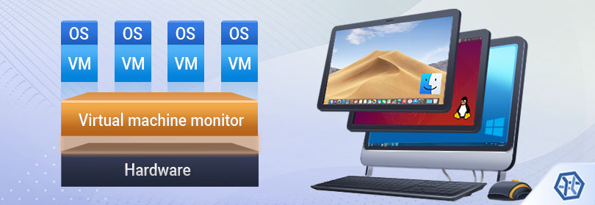
Virtual Machine
https://www.ufsexplorer.com/articles/storage-technologies/virtual-machines-data-organization.php
Notes:
A virtual machine is the virtualization/emulation of a computer system.
Virtual machines are based on computer architectures and provide the functionality of a physical computer.
The virtual machine monitor is called hypervisor; it is a computer software, firmware or hardware that creates and runs virtual machines.
Each VM is a full scale operating system.

Slide 19

Sharing is caring
More details on shared kernel resources
Software
Software
Software
Software
Docker
OS Ubuntu
Kernel
Notes:
Docker differs in a way that it shares as many resources as possible.
Each container only has the additional software that is necessary to run the application inside.
It shares all system libraries with the OS kernel

Slide 20
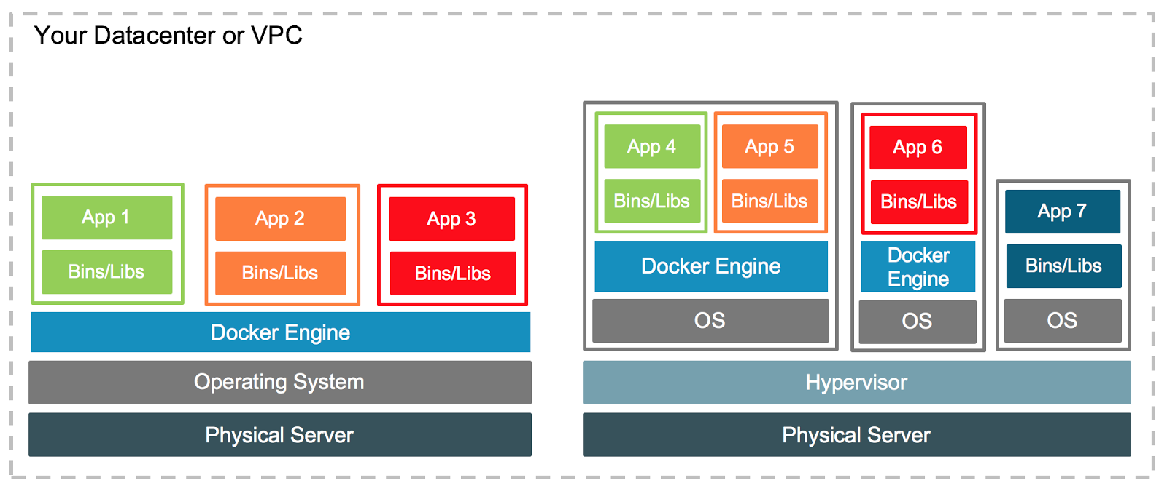
Docker and Virtual Machines
Notes:
Virtual machines and Docker are not exclusive, rather the opposite, they are run together quite often.
Tools like Vmware’s vSphere, a virtualization platform, transforms data centres into computing infrastructures. Amazon AWS and Google Cloud platform provide using a similar approach VM’s on demand which then in turn host docker engines that run containers.
This makes it possible to run a mix of VMs, docker container, operating systems, networks etc.
The world is your oyster.

Slide 21
Container limits
All system calls and namespaces used by the container need to be supported by the Kernel underlying Docker
https://www.redhat.com/en/blog/limits-compatibility-and-supportability-containers
Notes:
At this point I would like to quickly point out the limitation that I am aware off.
As docker containers use Kernel namspaces and system calls, the underlying kernel must be able to understand everything we are doing.
If we for example make use of the time namespace on an old kernel, it will not work.
It is a rare occurrence, I have not had an issue with it, and I also believe that it will be less and less of an issue in the future.

Slide 22
Docker
Notes:
After all this theory, let’s finally get into more practical aspects of Docker

Slide 23
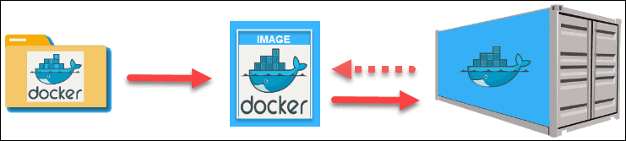

Docker workflow
build
run
Notes:
It all starts with a script of instructions that define how to build a specific Docker image.
This script is called a Dockerfile The file automatically executes the outlined commands and creates a Docker image.
The command for creating an image from a Dockerfile is docker build.
The image is then used as a template or base to run an application.
The application needs an isolated environment in which to run – a container.
Let's go through the components in a bit more detail.
What exactly is a Dockerfile?

Slide 24
Dockerfile
FROM alpine:3.13 AS builder
RUN apk update && \
apk upgrade && \
apk add git ca-certificates
RUN git clone --depth 1 https://github.com/lh3/bwa.git
RUN apk add make gcc libc-dev zlib-dev
WORKDIR /bwa
RUN make
FROM alpine:3.13
COPY --from=builder /bwa/bwa /usr/local/bin
WORKDIR /mnt
ENTRYPOINT ["bwa"]
CMD []
Notes:
A Dockerfile is a text document that contains all the commands a user could call on the command line to assemble an image.
The example above shoes instructions to build an image containing the famous bwa
Docker instructions are written in bold.
Each instruction creates a layer in the image.
Everything necessary to compile bwa is added as instruction
The details of these instructions though is beyond what we can cover in this course.
Next is the image.

Slide 25
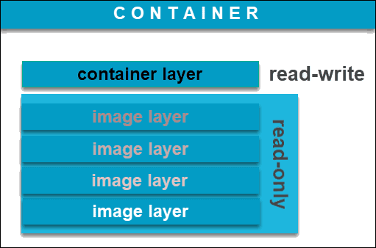
Docker image and container
Notes:
A Docker image is an immutable file that contains the source code, libraries, dependencies, tools, and other files needed for an application to run.
Due to their read-only quality, these images are sometimes referred to as snapshots.
They represent an application and its virtual environment at a specific point in time.
This consistency is one of the great features of Docker.
It allows developers to test software in stable and uniform conditions.
Since images are, in a way, just templates, you cannot start or run them.
What you can do is use that template as a base to build a container. A container is, ultimately, just a running image.
Once you create a container, it adds a writable layer on top of the immutable image, meaning you can now modify it.
Again, the image-base on which you create a container exists separately and cannot be altered.
Many tools have already been made available as docker images.
Where can we find them?
We discuss 2 resources here.

Slide 26


Image sources
World’s largest repository of container images (5.5m, 13b DL/month)
Teams & Organizations
Manage access to private repositories of container images.
Official Images
Pull and use high-quality container images provided by Docker.
Publisher Images
Pull and use high- quality container images provided by external vendors.
Builds
Automatically build container images from GitHub and Bitbucket and push them to Docker Hub.
Webhooks
Trigger actions after a successful push to a repository to integrate Docker Hub with other services.
https://hub.docker.com/
Community-driven project
Specialised in bioinformatics tools
Provides the infrastructure and basic guidelines to create, manage and distribute bioinformatics packages (e.g conda) and images (e.g docker, singularity)
Provide guidelines and help on how to create reproducible pipelines and workflows using bioinformatics containers.
Users are able to request an image to be created.
https://biocontainers.pro/
https://academic.oup.com/bioinformatics/article/33/16/2580/3096437
Notes:
Dockerhub and BioContainers
Dockerhub is the world larges repository.
You find images of all major operating systems, databases, programming languages etc
They provide curated seta of Docker repositories called official images.
Another trustworthy image type are Publisher images, which are images provided by verified commerical entities
Dockerhub is also the default source when downloading (aka pulling) images using the docker command line interface.
Biocontainers is a community driven project, focusing on bioinformatic tools.
Most of commonly used tools are available, and users are able to request for any tool to be made available in an image.

Slide 27
Commands
Docker [command] --help
Download an image:
docker pull ubuntu
Create a container from an image
docker run ubuntu:18.04 ls -l
#If you dare:
docker run ubuntu:latest rm -rf /
#docker run and docker container run are equivalent
Create a container from an image with a name
docker run --name nginx -d nginx
Run a command in a running container
docker exec a24faeb0b374 ls –l
List all images
docker images # docker image ls
List all container
docker container ls
Open a shell in container (debug)
docker run -it --rm --entrypoint bash juettemann/genrich
# No BASH use sh
docker run -it --rm alpine sh
Stop a running container
docker stop a24faeb0b374
Kill a running container
docker kill a24faeb0b374
Only use --rm in a test environment!
Notes:
Here we have an overview of commonly used commands.
The structure of the commands should be apparent, it starts with docker,` followed by a command and options.
The most important one to remember is --help.
It can be added to any command for more information.
The first command downloads (pulls) the latest ubuntu image from dockerhub.
Next we see how to create a container from image.
Finally, the thing we have been working towards the whole time.
Using ubuntu version 18.04, it creates a container from the image and execute ls -l in the starting directory in the container, which is /.
I would like to mention that docker run & docker container run are the same.
If you are very daring, a container allows you to do all the things you can't do outside, you finally can push that red button
Naming a container is often helpful, as well as starting it in a detached mode in the background which we see in the next command.
Most of the other commands should be self-explanatory, and we will use most of them in the practical.
I like to mention two more examples.
Both are part of the "Open a shell in a container".
The first is the option --entrypoint. Entrypoint is a docker instruction used in an image file to tell what to do when the container starts. In this case it is execute genrich. This behavior can be overwritten by using the entrypoint option.
The other one is the use of --rm.
Using it will delete the container once it is finished, which means there won’t be any log to inspect.
Only use it when testing or debugging, but not in a production environment.
If the container fails, you have no way to find out why it did so.
Lastly, I highly recommend to start creating your own cheat sheet.
As you have learned by now, docker is a simple, but complex tool and having a list with commands and notes is really helpful

Slide 28
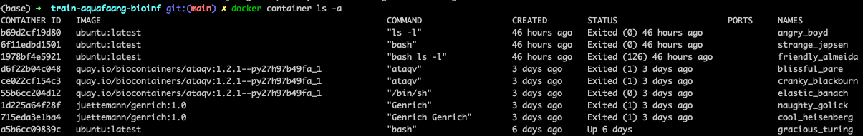
Identifying a docker object
Naming generator: https://github.com/moby/moby/blob/master/pkg/namesgenerator/names-generator.go
Notes:
The last part of this introduction is how Docker identifies objects.
An object can be a container, an image, a network etc.
All objects are identified by an universally unique identifier (UUID), which is a 128-bit label.
When interacting with Docker you can either use the whole string (next slide), or the short version displayed with the ls command.
In fact, you only need to type as many character as necessary to have a unique string.
Container also have a name.
This name can either be assigned by you, or it is automatically generated from a list of adjectives and famous scientists or hackers.
That is list can be extended!

Slide 29
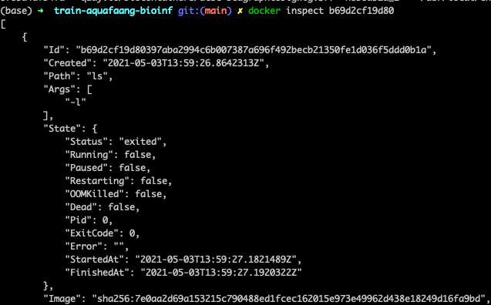
Inspecting a container
Notes:
We can find more information about a docker object by inspecting its UUID (short or long).
This can give you valuable information

Slide 30
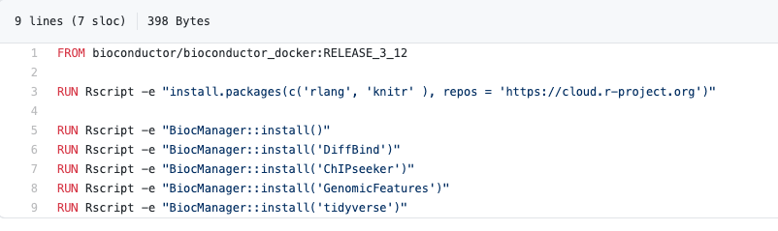
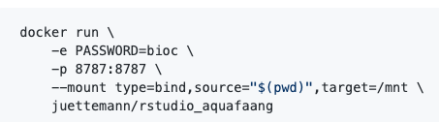
R-Studio
https://github.com/juettemann/containers/tree/master/rstudio_aquafaang
Notes:
Lastly an example of how easy docker can make things.
While preparing for this course, I was in need for Rstudio with a few packages installed.
I tried installing it on my machine and a VM, but after about 20 min of compiling, it failed.
Instead of spending time debugging the reason, I simply created a small Dockerfile, build it, and voila – I had working version of R-Studio with all dependencies!

Slide 31
Questions?

